Slide 1
From Empathy
to Compassion
In the MI Context
ICIS
Interagency Council on Intermediate Sanctions
Brought to you by

Slide 2
What is Empathy?
An active interest in an effort to understand the others’ internal perspective; to see the world through their eyes.
(Mouse over icon for audio presentation)

Slide 3
Empathy to Compassion
Take a moment to be present and actively listen.
(Mouse over icon for audio presentation)

Slide 4
Empathy to Compassion
CoP Practice (Worksheet on last slide)
Instructions:
Part 1 – Accurate Empathy
Think of a client, or any person you know, with very different life experiences.
Identify an experience that person has had that is unfamiliar to you (such as homelessness).
Imagine and write down three feelings you might associate with that person’s experience (e.g., tired, fearful, lonely).
Write down a couple experiences you’ve had with those feelings in your own context.

Slide 5
Empathy to Compassion
CoP Practice (Worksheet on last slide)
Instructions:
Part 2 – Spirit of Compassion with Active Listening
In response to your own experiences:
Write two complex reflections
and
one elaborating open question.
Share and discuss your work with your CoP

Slide 6
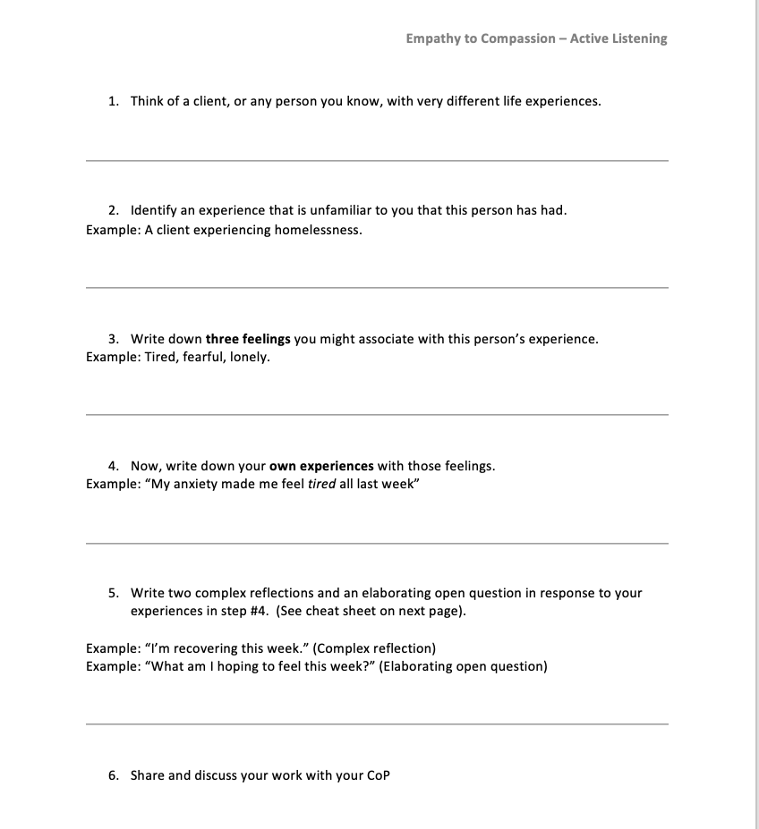

Slide 7
