Slide 1
January 2020 Ebp Tip of the month: carvedham
According to Bill Miller, the co-creator of Motivational Interviewing, Reflections are the skills that best represent what Motivational Interviewing is about.
There are two types of Reflections: Simple Reflections and Complex Reflections. Complex reflections is a higher skill. Simple Reflections reflect back content or emotion. Complex Reflections go beyond what is said and can offer a new perspective and may shift a person's understanding or feeling about the situation.
There are 9 types of Complex Reflections that can be referred to as CARVED HAM

Slide 2
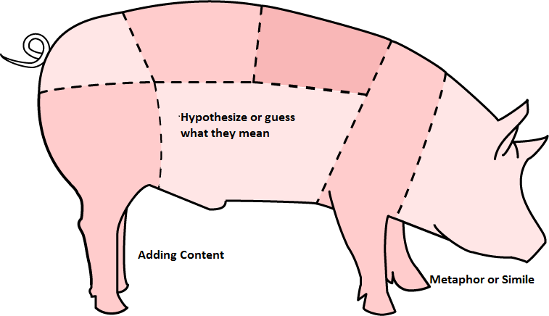
The last 3 Complex Reflections are the “HAM”:
7) HYPOTHESIS TESTING: Sometimes reflections can feel like the interviewer is “pulling it out of thin air” and the statement is not relevant to what the client just said. If it is still a statement and not a question, and the interviewer seems to be testing a hypothesis that the client may not have considered, even if seemingly random, it is still a complex reflection.
8)ADDING CONTENT: The interviewer adds meanings for feelings that the client did not express.
9) METAPHOR OR SIMILE: The interviewer uses “picture language” to describe something the client had used plain language for.

Slide 3
Click for audio
Statement: I want to lose weight, but I just love to eat, especially sugary treats, I can’t stop myself when they are in the house, I know it’s not good for me.
7. HYPOTHESIS OR GUESS WHAT THEY MEAN
Sounds like you can’t control yourself around food
8. ADDING CONTENT
It sounds like you are setting a bad example for your kids
9. METAPHOR AND SIMILE
a. You want to show others you can tame this lion
b. Your house is like a candy store

Slide 4
PRACTICE STATEMENTS. Try to use the HAM reflections on these statements
I’m glad I got probation and not jail however coming to see you every week, picking up my kids, and going to work is really hard for me to do. I don’t think I can do all of them.
I like to pay my restitution because I know I was wrong but I also have to pay child support and rent.
I’m learning a lot from going to treatment and I’m enjoying sobriety but I find hard to stay away from my old criminal friends since I’ve known them all my life.

